Slide 1


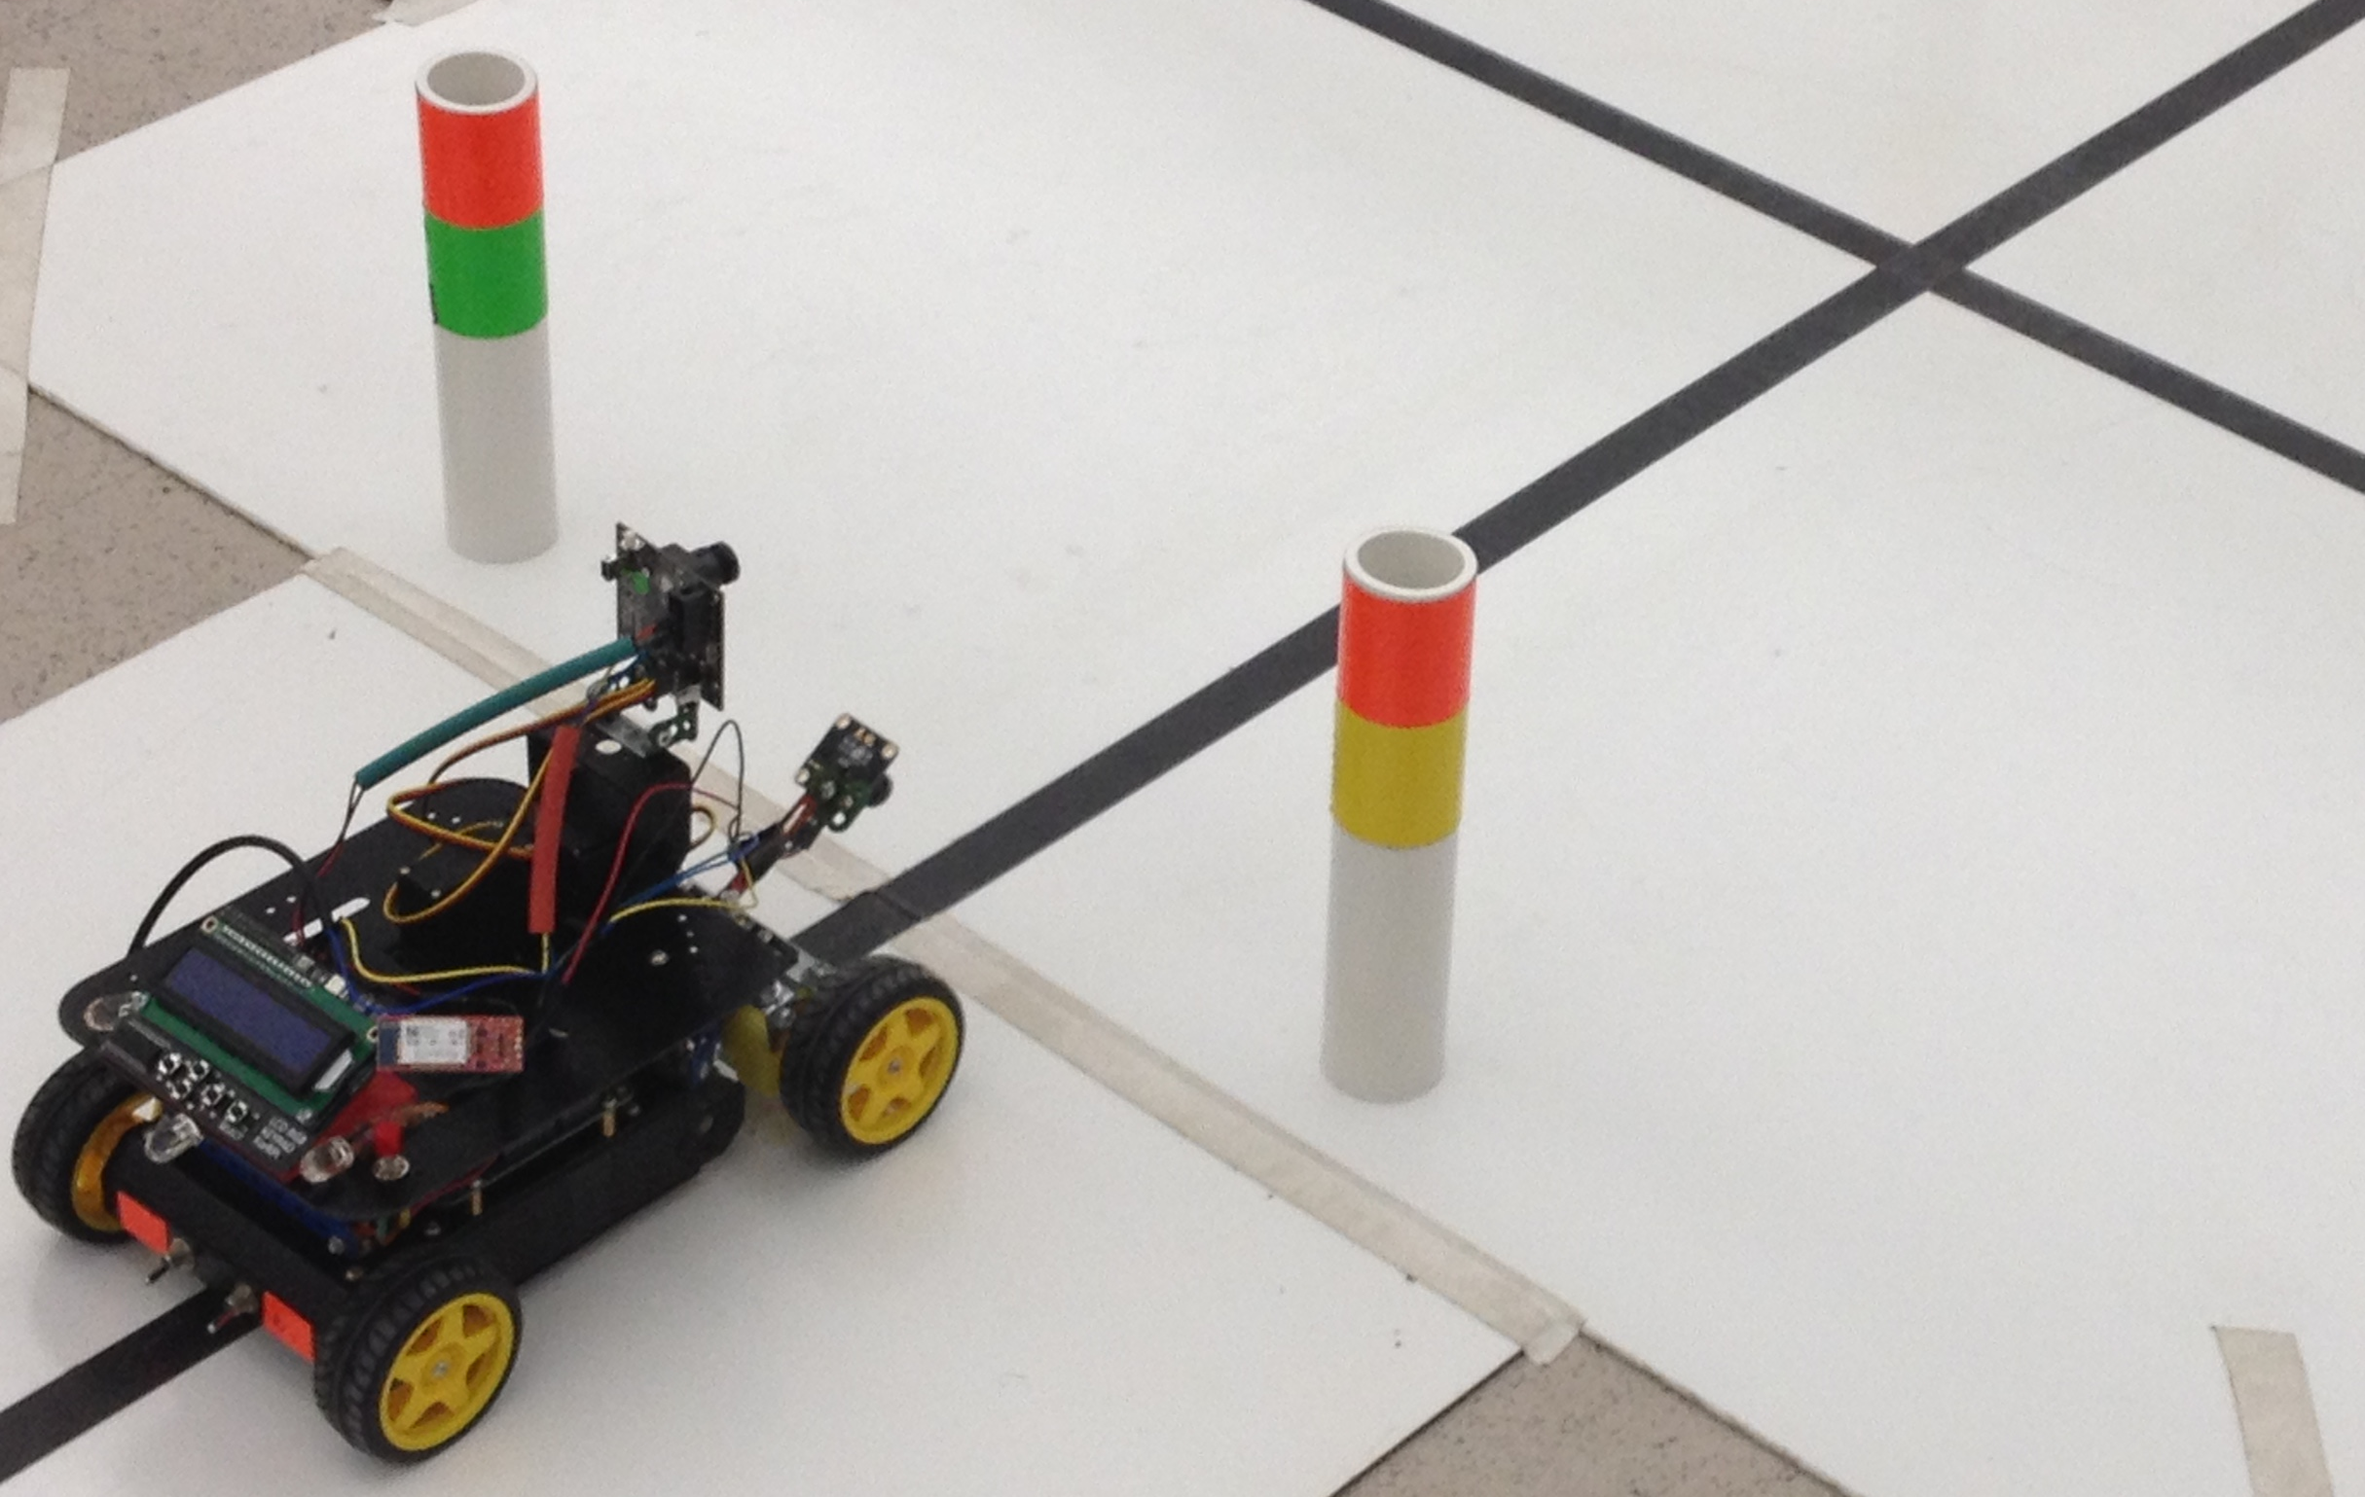
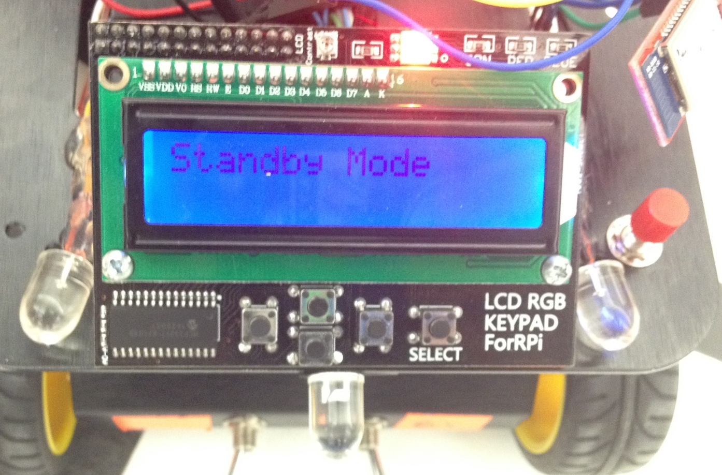
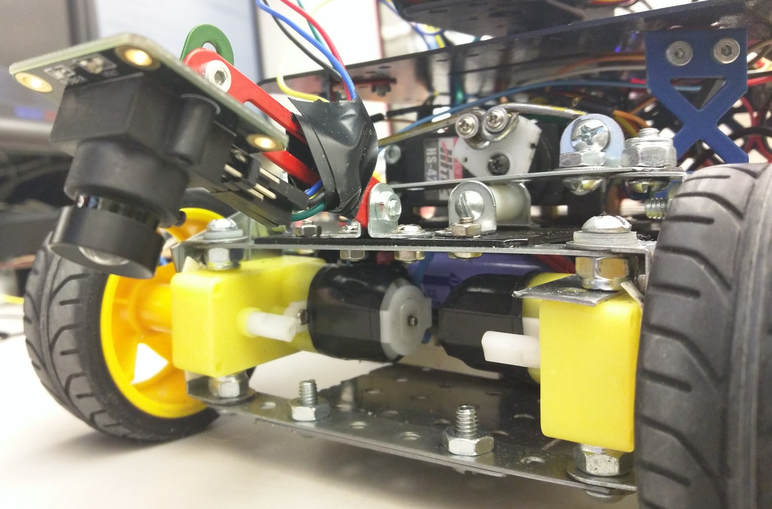
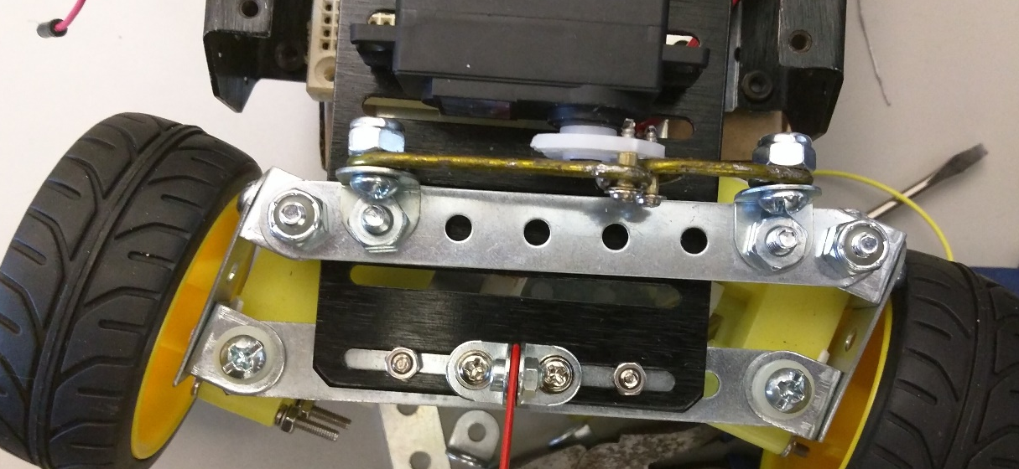
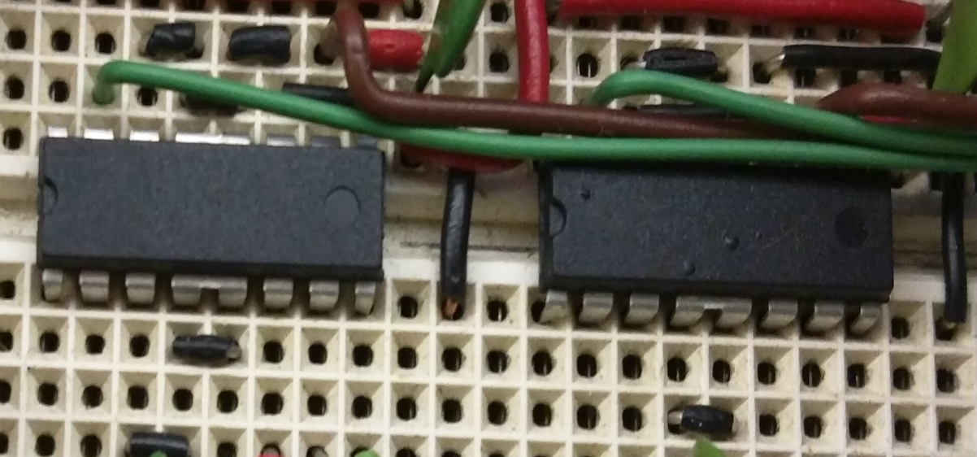
Intelligent Line & Marker Tracking Car
Straight Outta CompE (SOC)
Zachary Rauen, Juan Merchan, Jayesh Bokhiria
Abstract:
Designed and built a third generation “intelligent” car, the system has the capability to follow a black line against a white background. The system navigates autonomously around a track and also be able to find the track if placed outside the track. The system uses two vision sensors to process information and make decisions based on its location. One sensor can be used to detect the markers on the track instructing to the car system to turn left, right, turn around, or continue when it comes to an intersection on the track.
Additional Features:
LCD
Interfaces with the user allowing them to see the current mode selection. The LED attached to the panel allows the user to see the operating mode.
Bluetooth
The Bluetooth is used in combination with an SD card to log data about the car while its working.
Blinkers
The indicators allow the user to see what direction the car will turn at the intersection. It also gives a look into how the PIXY is working.
Brake Light
The brake light turns on when the car stops.
Overall Functionality:
Discovery Mode:
The car is placed within 2ft of the edge of track, the car locates the track and completes the track while following the commands from the markers and stops at start/stop line.
Accuracy Mode:
The car follows the black line on the track as closely as possible until it has completed two laps while following the commands from the markers and stops at start/stop line.
Speed Mode:
The car navigates the track as fast as possible while following the black line. Completes two laps while following the commands from the markers and stops at start/stop line.
Results & Analysis:
The car was able to successfully complete the requirements of all three modes.
The additional features were all seamlessly incorporated into the system and actually helped with debugging.
After much noise reduction, the Hybrid-PID was highly successful.
Steering + Hybrid-PID Control:
By itself, the steering allows the car to make quick small adjustments.
Implemented to compensate for understeer.
Has 3 PIDs – one for steering, one for the two left hand side motors, and one for the right hand side.
The motor PIDs only activate when steering has overflow.
Allows the car to make the gradual turns at speed.
Hardware
FRDM-K64 Board | 3D Printed LCD holder
CMUCam5 Pixy Vision | TAOS Linear Sensor Array
BlueSMiRF Bluetooth | Four Wheels w/ Motors
LCD Panel | H-Bridge

